Slide 1

CSS 1
Batch 17 | Bootcamp Frontend Web Development

Slide 2


Frontend Developer
Rizky Ramadhan
at Telkom Indonesia (2021 - present)
Mentor
Tech Content Creator
2022 - present
Frontend Dev @Telkom Indonesia
Tech Content Creator
Frontend Mentor
at dibimbing.id (2022 - present)
LinkedIn:
/in/rizkykyra

Slide 3
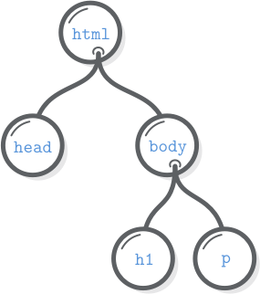


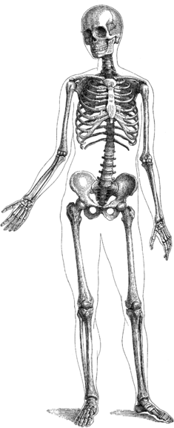


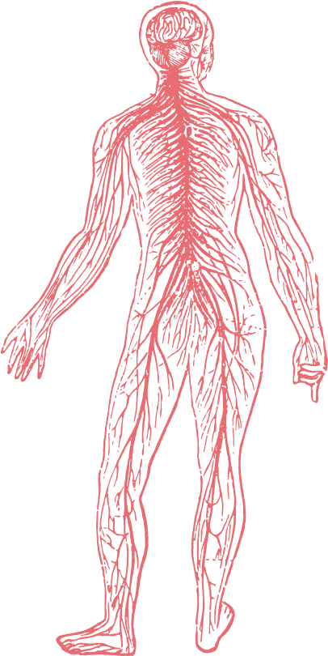



Front-End Development
HTML adds meaning to plain content by using special tags.
CSS is for styling the structured content created with HTML.
JavaScript adds interactivity to the structured content and styling created with HTML and CSS.
HTML the Skeleton
CSS the Human Body
JavaScript the Brain

Slide 4
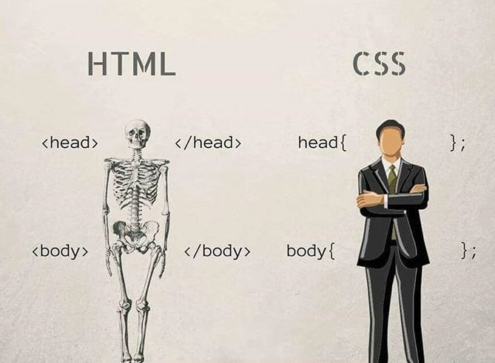
1 of 20

Slide 5
Outline
Importing CSS
CSS Syntax Structure
CSS Selector
CSS Color
Fonts
Text Alignment
List
CSS Hierarchy
Pop Quiz
CSS Hands On

Slide 6
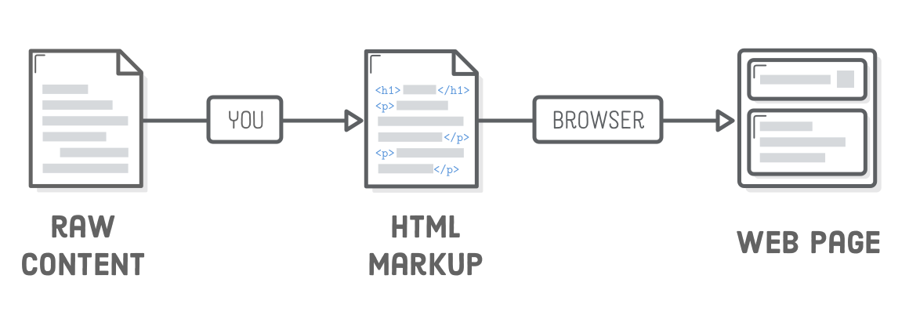
Front-End Development

Slide 7
Importing CSS Files
There are 3 ways to import the CSS Files. Anyone know?

Slide 8
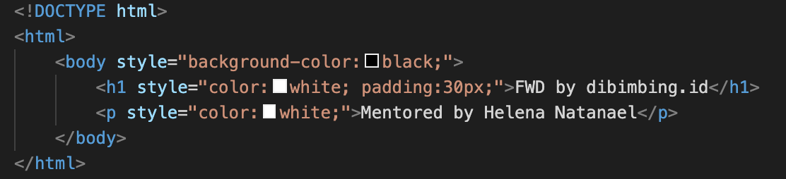
1
Inline CSS
Pros:
styles only applied within the scope, good for small changes
Cons:
will make code less readable if the styles applied is complex

Slide 9
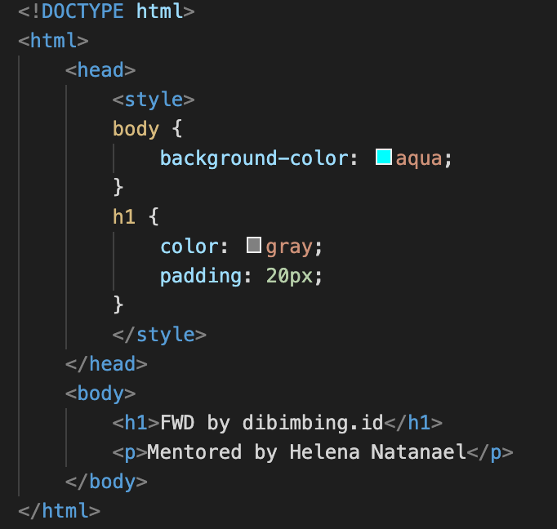
2
Internal CSS
Pros:
can reuse style for some elements
can use CSS selector
Cons:
will make too long line of code if applied in complex page
styles only applied within the file, cannot be reused in different html file

Slide 10
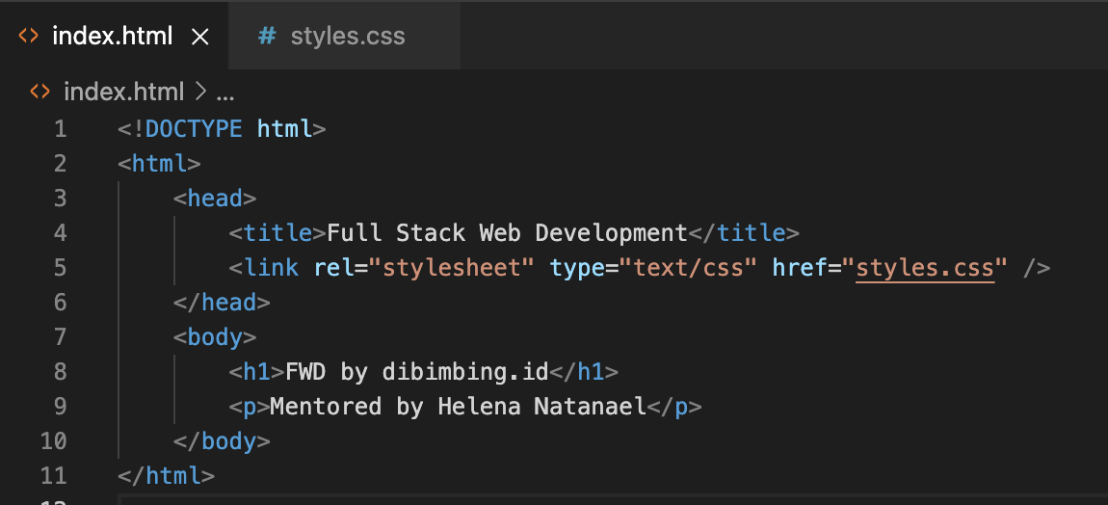
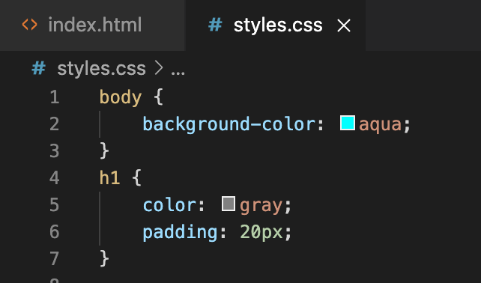
3
External CSS
Pros:
neat code structure, easy to maintain, readable
styles can be reused across files / pages
can use CSS selector
Cons:
css will not be loaded if the path is wrong (typo, server structure)
styles will not be applied in the page until the file is fully loaded in network

Slide 11
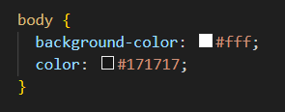
CSS Syntax Structure
property
selector
value
declaration
]
declaration
block
declaration

Slide 12
CSS Selector
There are 5 ways to select the part of HTML
that we want to style:
Class selector
ID selector
Tag selector
Attribute selector
Universal Selector

Slide 13
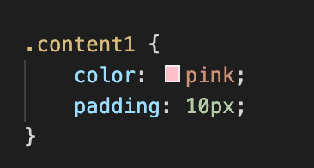
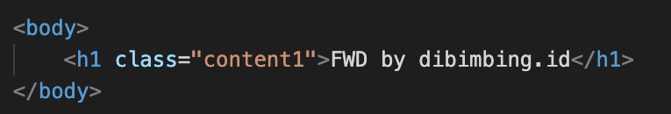
1
Class Selector
Select class of the element that we want to style.
Most used selector in modern Web Apps.

Slide 14
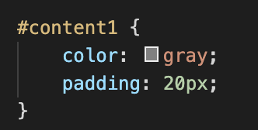
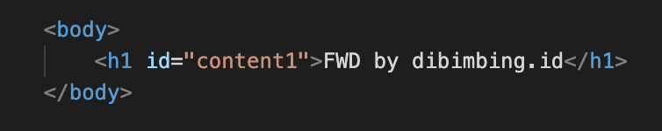
2
ID Selector
Select ID of the element that we want to style.
Pros:
useful if we want to use specific style for an element in the page
Cons:
not suitable if want to apply the style in some elements, because can only used once

Slide 15
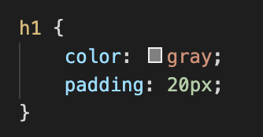
3
Tag Selector
Select directly the tag that we want to style, example: h1, div, span, img, p, etc.
Pros:
useful if we want to use same style for all same tag in the page
Cons:
in real life, this is rarely used (usually only used for heading tag) because each tag usually has their own style

Slide 16
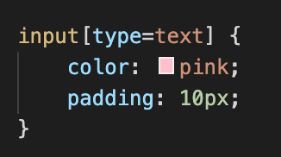
4
Attribute Selector
Selecting a tag selector and make it specific by using their attribute.
Not all HTML tag can use this.

Slide 17
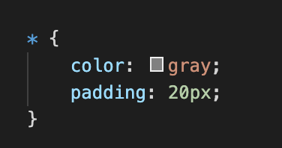
5
Universal Selector
Apply the style into all elements in HTML page

Slide 18
Let’s Code

Slide 19
Color
There is some classifications of color in HTML. Let’s discuss it one by one!

Slide 20
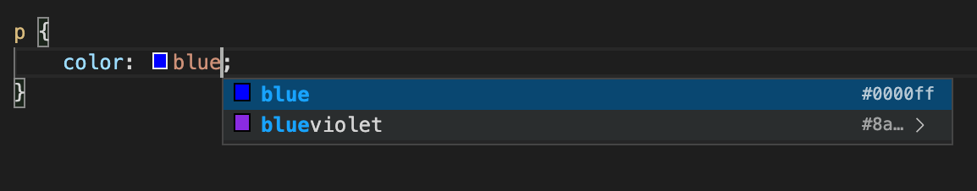
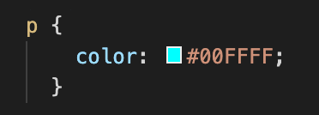
1 Named Colors
2 Hex Colors
14 of 20

Slide 21
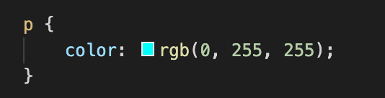
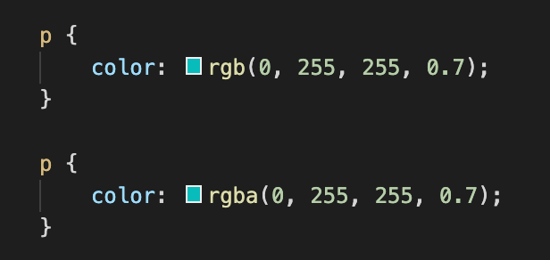
3 RGB (Red Green Blue) Colors
4 Alpha Channel for Opacity
15 of 20

Slide 22
Let’s Code

Slide 23
Ice Breaking

Slide 24
Font
font-family
font-weight
font-size
line-height

Slide 25
Let’s Code

Slide 26
Text Alignment
Just like MS Word, we can set text alignment in a Web App. property name: text-align
values: left, right, center, justify, inherit

Slide 27
Let’s Code

Slide 28
List
in HTML, there is 2 type of list: unordered list (ul) and ordered list (ol). We will discuss about list styling using CSS.
Properties: list-style-type, list-style-position, list-style-image Demo: https://codepen.io/impressivewebs/pen/tIEKG

Slide 29
Let’s Code

Slide 30
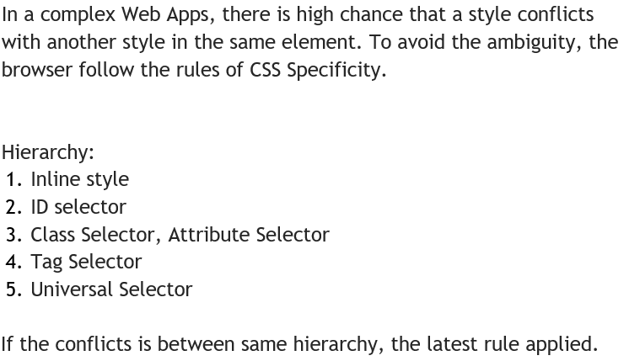
Insights: CSS Specificity

Slide 31
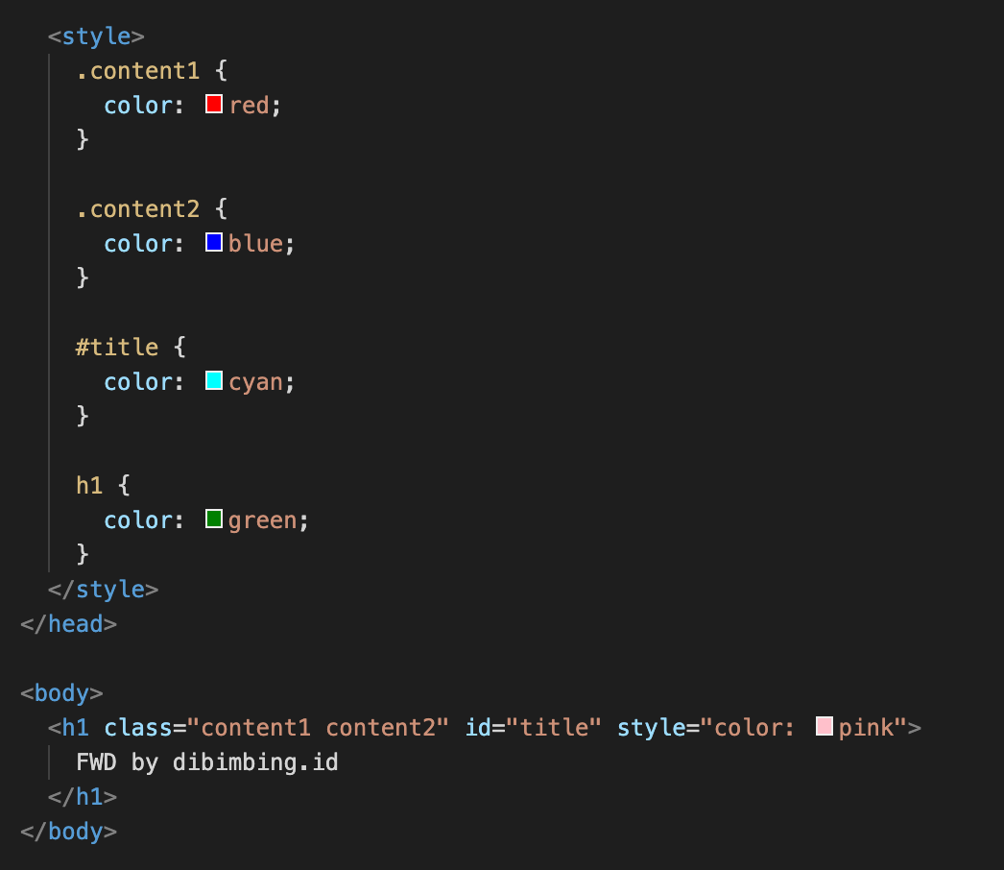
Pop QUIZ!
Let’s determine, which style is applied into this code snippet?

Slide 32
Hands On
Create 2 website pages that use each CSS file with the following folder structure:
css
- home.css
- about.css
- index.css
html
- home.html
- about.html
-index.html
Index.html is just a page that have a button to redirect to home/about page, you can give a style to index.html too
Use every CSS property that we’ve learnt today

Slide 33
Terima
Kasih.
Let’s discuss! ======================= reference: developer.mozilla.org

